Slide 1



Course: Image Processing 31651 Assignment #11 Synthetic Image Creation (Part 1) – version 3
1
Photo of the student | Shorten Name | ID (4 last digits)
 | shienfeld | 1950 | Student #1
 | pony | 2210 | Student #2
 | akimov | 7939 | Student #3

Slide 2
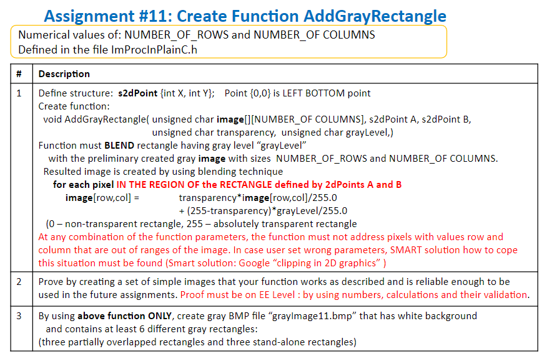
2

Slide 3
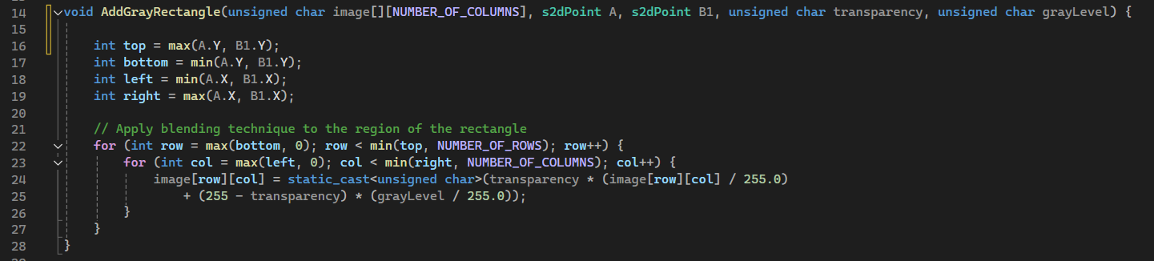
11.1 - Code of the function “AddGrayRectangle”
3

Slide 4
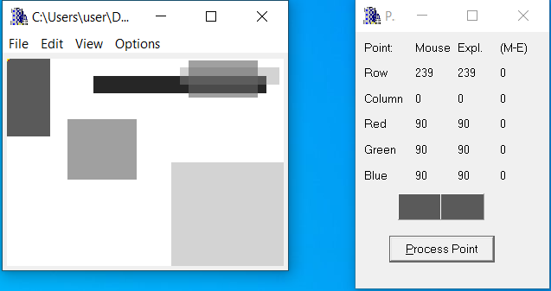
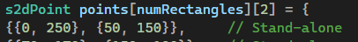
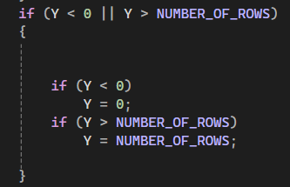
11.2 - List of situations tested – part 1
4
The point we test
In order to test clipping from the top (row direction) -we changed the value of the first rectangle from 239 to 250 – increase by 11 – to test the clipping. We expect the rectangle will be drawn and the point will be the at B1 max value which is 239!
The code for preventing clipping in the y direction (located at the header file)
As expected!

Slide 5
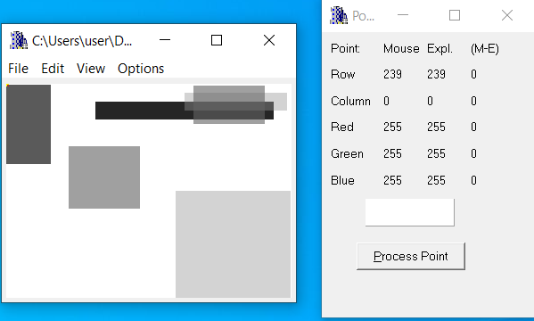
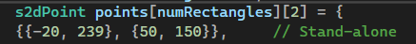
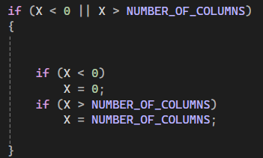
11.2 - List of situations tested – part 2
5
The point we test
In order to test clipping from the left (column direction) - we changed the value of the first rectangle from 0 to -20 – decreasing by 20 – to test the clipping. We expect the rectangle will be drawn and the point will be the at A min value which is 0!
The code for preventing clipping in the x direction (located at the header file)
As expected!

Slide 6
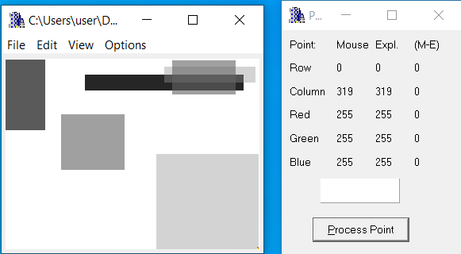
11.2 - List of situations tested – part 3
6
In order to test clipping from the bottom (row direction) - we changed the value of the third rectangle from 0 to -10 – decreasing by 10 – to test the clipping. We expect the rectangle will be drawn and the point will be the at B1 min value which is 0!
The code for preventing clipping in the x direction (located at the header file)
The point we test
As expected!

Slide 7
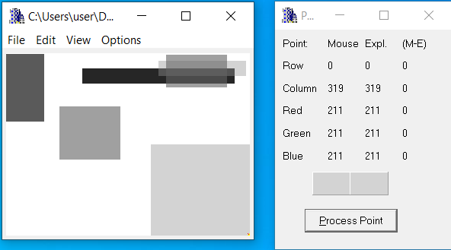
11.2 - List of situations tested – part 4
7
In order to test clipping from the right (column direction) - we changed the value of the third rectangle from 319 to 340 – decreasing by 21 – to test the clipping. We expect the rectangle will be drawn and the point will be the at A min value which is 319!
The code for preventing clipping in the y direction (located at the header file)
The point we test
As expected!

Slide 8
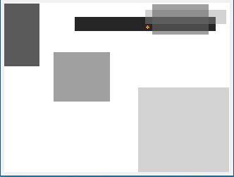
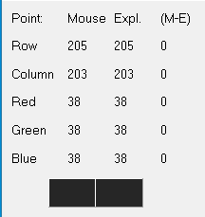
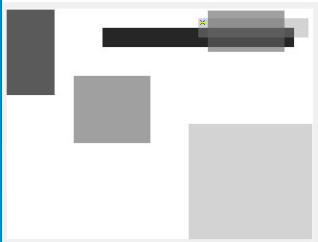
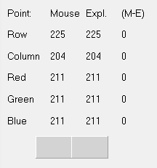
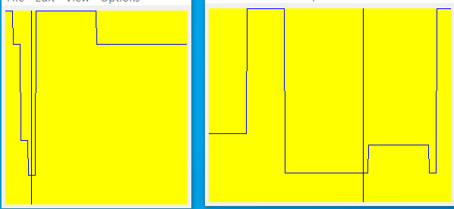
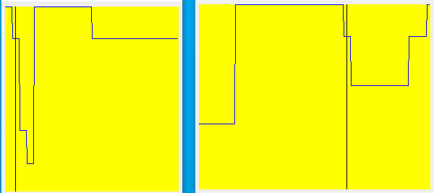
11.3 - For the specific test images (see 11.2) - relevant profiles and refer relevant lines of code to prove that specific test having specific rectangle were created as required – part 1
8
b
a

Slide 9

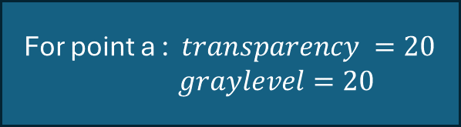
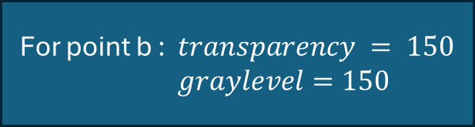


11.3 - For the specific test images (see 11.2) - relevant profiles and refer relevant lines of code to prove that specific test having specific rectangle were created as required – part 2
9
image[row,col] = transparency*image[row,col]/255.0 + (255-transparency)*grayLevel/255.0
For point b : $transparency = 150$
$graylevel=150$
For point a : $transparency =20$
$graylevel=20$
$$image_{b}=150∗\frac{255}{255}+\left(255−150\right)∗\left(\frac{150}{255}\right)=211.7$$
$$image_{a}=20∗\frac{255}{255}+\left(255−20\right)∗\left(\frac{20}{255}\right)=38.4$$
Real results
Real results

Slide 10
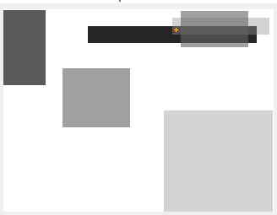
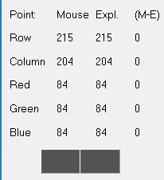
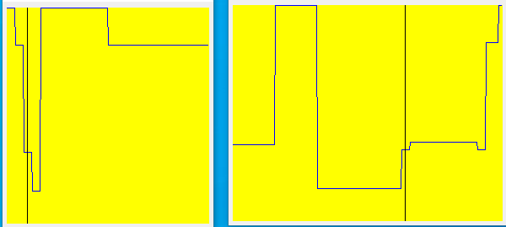
11.3 - For the specific test images (see 11.2) - relevant profiles and refer relevant lines of code to prove that specific test having specific rectangle were created as required – part 2
10
c
For point c : צריך לצאת 173 בגלל 211-38

Slide 11
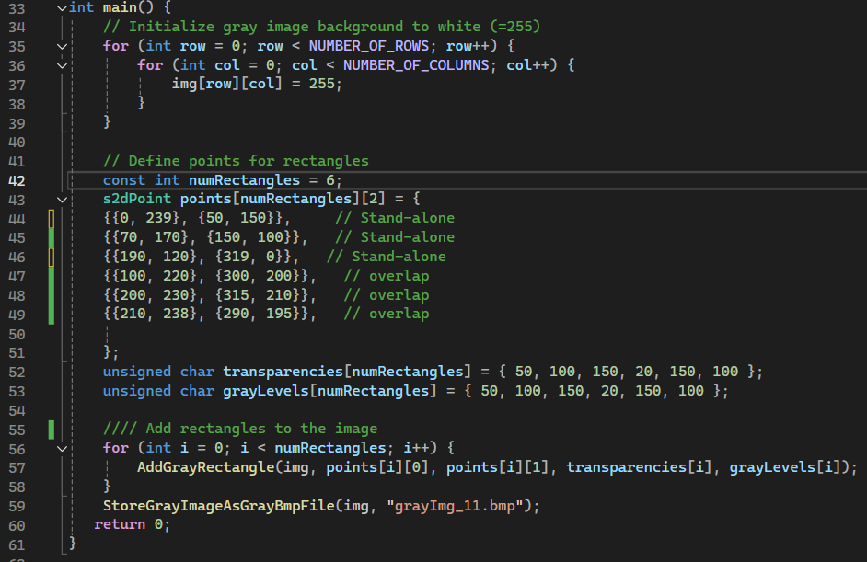
11.4 - Code of the “main” function and set of intermediate images - part 1
11
In addition – as mentioned before – the s2dpoint struct & the validation process to prevent clipping in located at the header file

Slide 12



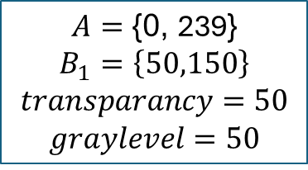
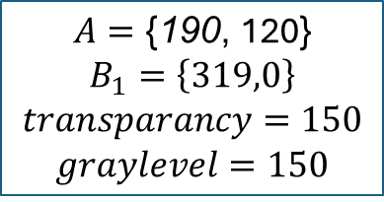

11.4 - Code of the “main” function and set of intermediate images - part 2
12
The set of the intermediate images – every new rectangle (6 total) will be numbered and its A and B1 coordinates & their transparencies and gray levels – will be written next to the new image
1
2
3
$$A=\text{\{}\text{0}\text{,} \text{239}\text{\}}$$
$$B_{1}=\left\{50,150\right\}$$
$$transparancy=50$$
$$graylevel=50$$
$$A=\text{\{}\text{7}\text{0}\text{,} \text{170}\text{\}}$$
$$B_{1}=\left\{150,100\right\}$$
$$transparancy=100$$
$$graylevel=100$$
$$A=\text{\{}\text{190}\text{,} \text{120}\text{\}}$$
$$B_{1}=\left\{319,0\right\}$$
$$transparancy=150$$
$$graylevel=150$$
Continue in the next slide

Slide 13



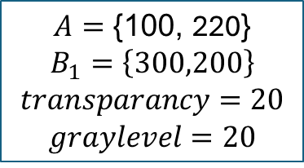
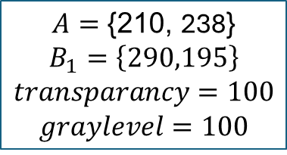

11.4 - Code of the “main” function and set of intermediate images - part 3
13
The set of the intermediate images – every new rectangle (6 total) will be numbered and its A and B1 coordinates & their transparencies and gray levels – will be written next to the new image
5
4
$$A=\text{\{}\text{10}\text{0}\text{,} \text{220}\text{\}}$$
$$B_{1}=\left\{300,200\right\}$$
$$transparancy=20$$
$$graylevel=20$$
$$A=\text{\{}\text{20}\text{0}\text{,} \text{230}\text{\}}$$
$$B_{1}=\left\{315,210\right\}$$
$$transparancy=150$$
$$graylevel=150$$
6
$$A=\text{\{}\text{21}\text{0}\text{,} \text{238}\text{\}}$$
$$B_{1}=\left\{290,195\right\}$$
$$transparancy=100$$
$$graylevel=100$$

Slide 14
11.4 - Code of the “main” function and set of intermediate images - part 4
14
The final form – all 6 rectangles – is:

Slide 15
11.5 – what did we learned?
15
We learned how to use the bmp viewer
How overlapping creates different shades from the original and how its calculated
How to avoid clipping using smart solutions

